Slide 1

NAME: E.G.PRADEEP ROLL NO : RA2211004050026 DEP: B.TECH.ECE SUB: DESIGN THINKING METHODOLOGY SUB CODE : 21DCS201P

Slide 2
VISUALIZATION OF STAKEHOLDERS : 1.A STACKEHOLDER IS A PERSON,GROUP,OR ORGANIZATION THEIR OPINION ARE IMPORTANT AND CAN IMPACT THE BUISENESS’S ABILITY TO ADVANCE PRODUCT STATERGY,CREATE A ROADMAP,AND EXECUTE IT. 2.STACKHOLDERS CAN BE INTERNAL OR EXTERNAL,AND CAN HAVE A DIRECT OR INDIRECT INFLUENCE ON THE ORGANIZATION’S ACTIVITIES. 3.Stakeholders are often responsible for making key decisions throughout the project lifecycle. This includes decisions related to project planning, resource allocation, risk management, and overall strategy. 4.. They provide input based on their interests, needs, and expectations, helping to shape the direction of the project. 5.Stakeholders typically monitor the progress of the project to ensure that it is on track to achieve its objectives.

Slide 3
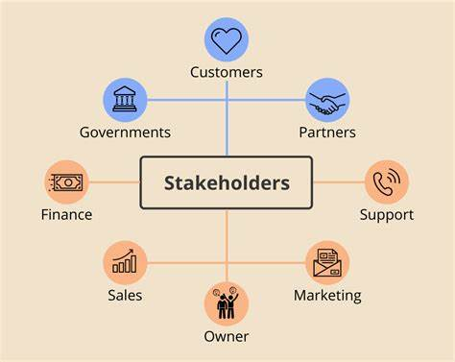
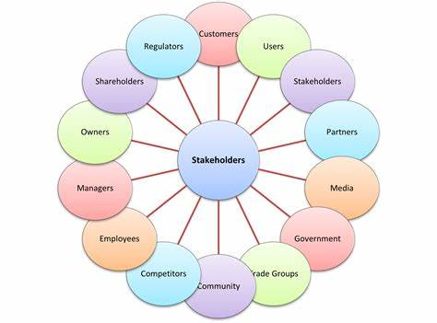

Slide 4
THANK YOU

